Slide 1

Chapter 3
Data and Signals
Copyright © The McGraw-Hill Companies, Inc. Permission required for reproduction or display.

Slide 2
3-4 TRANSMISSION IMPAIRMENT
Signals travel through transmission media, which are not perfect. The imperfection causes signal impairment. This means that the signal at the beginning of the medium is not the same as the signal at the end of the medium. What is sent is not what is received. Three causes of impairment are attenuation, distortion, and noise.
Topics discussed in this section:
Attenuation
Distortion
Noise

Slide 3
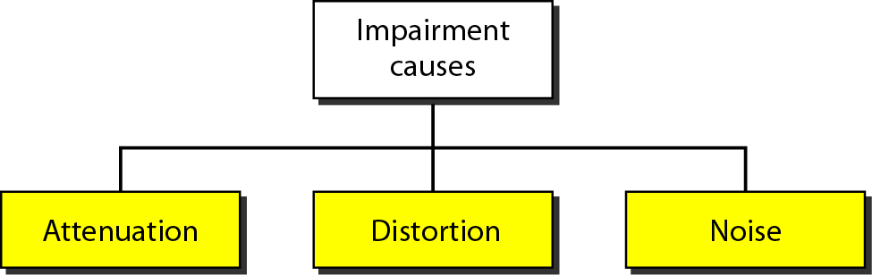
Figure 3.25 Causes of impairment

Slide 5
Attenuation
Means loss of energy -> weaker signal
When a signal travels through a medium it loses energy overcoming the resistance of the medium
Amplifiers are used to compensate for this loss of energy by amplifying the signal.

Slide 6
Measurement of Attenuation
To show the loss or gain of energy the unit “decibel” is used.
dB = 10log₁₀P₂/P₁
P₁ - input signal
P₂ - output signal

Slide 7
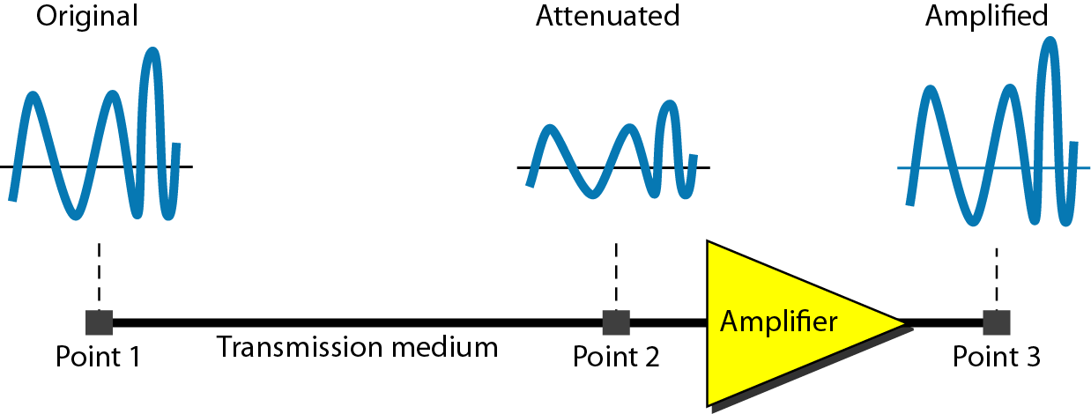
Figure 3.26 Attenuation

Slide 8

Example 3.26
Suppose a signal travels through a transmission medium and its power is reduced to one-half. This means that P₂ is (1/2)P₁. In this case, the attenuation (loss of power) can be calculated as
A loss of 3 dB (–3 dB) is equivalent to losing one-half the power.

Slide 9

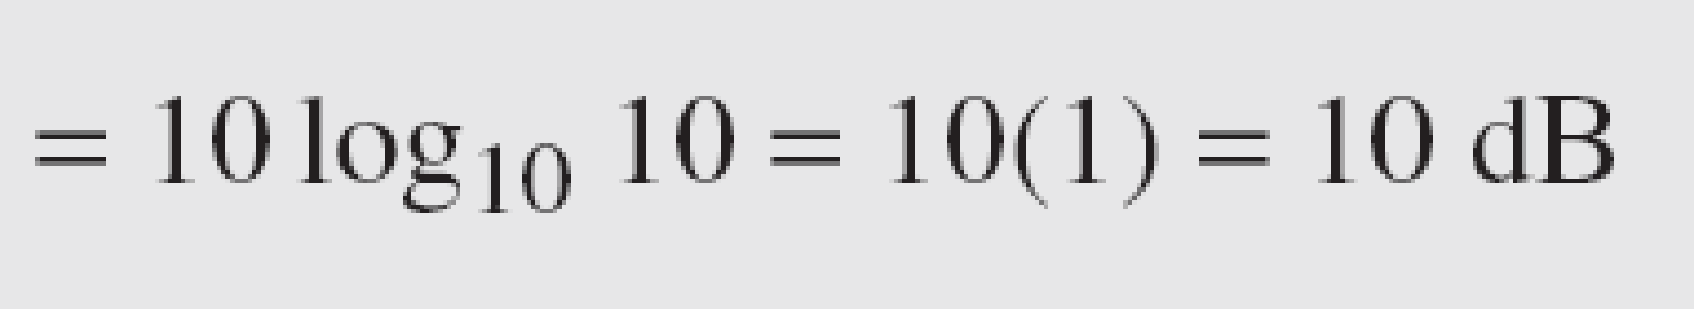
Example 3.27
A signal travels through an amplifier, and its power is increased 10 times. This means that P₂ = 10P₁ . In this case, the amplification (gain of power) can be calculated as

Slide 10

Example 3.28
One reason that engineers use the decibel to measure the changes in the strength of a signal is that decibel numbers can be added (or subtracted) when we are measuring several points (cascading) instead of just two. In Figure 3.27 a signal travels from point 1 to point 4. In this case, the decibel value can be calculated as

Slide 11
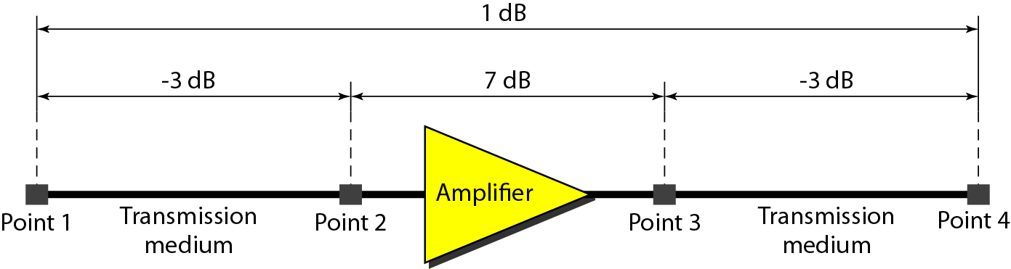
Figure 3.27 Decibels for Example 3.28

Slide 12
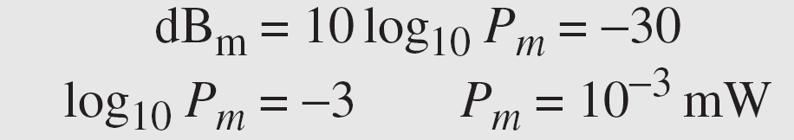
Example 3.29
Sometimes the decibel is used to measure signal power in milliwatts. In this case, it is referred to as dB_{m} and is calculated as dB_{m} = 10 log10 P_{m} , where P_{m} is the power in milliwatts. Calculate the power of a signal with dB_{m} = −30.
Solution
We can calculate the power in the signal as

Slide 13
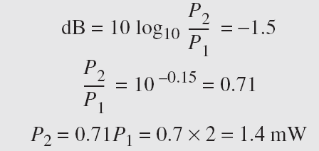
Example 3.30
The loss in a cable is usually defined in decibels per kilometer (dB/km). If the signal at the beginning of a cable with −0.3 dB/km has a power of 2 mW, what is the power of the signal at 5 km?
Solution
The loss in the cable in decibels is 5 × (−0.3) = −1.5 dB. We can calculate the power as

Slide 15
Distortion
Means that the signal changes its form or shape
Distortion occurs in composite signals
Each frequency component has its own propagation speed traveling through a medium.
The different components therefore arrive with different delays at the receiver.
That means that the signals have different phases at the receiver than they did at the source.

Slide 16
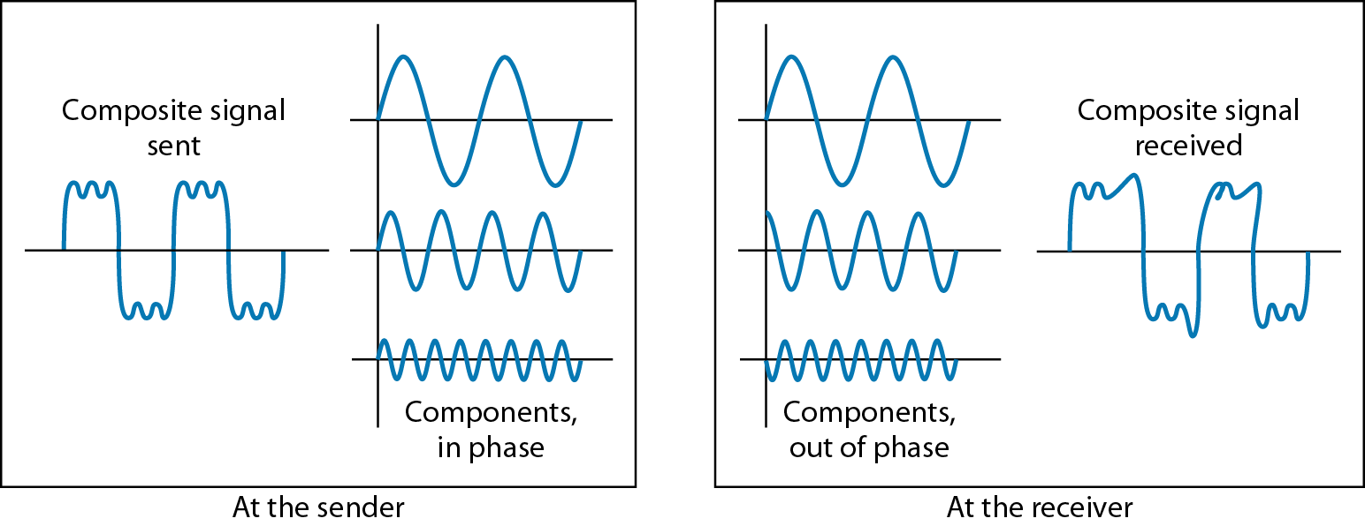
Figure 3.28 Distortion

Slide 18
Noise
There are different types of noise
Thermal - random noise of electrons in the wire creates an extra signal
Induced - from motors and appliances, devices act are transmitter antenna and medium as receiving antenna.
Crosstalk - same as above but between two wires.
Impulse - Spikes that result from power lines, lighning, etc.

Slide 19
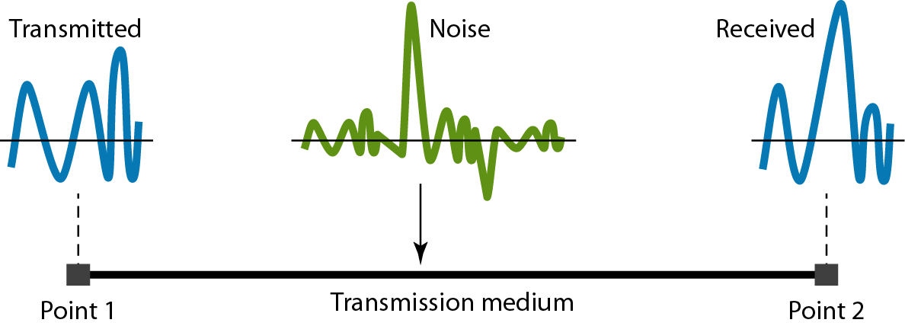
Figure 3.29 Noise

Slide 20
Signal to Noise Ratio (SNR)
To measure the quality of a system the SNR is often used. It indicates the strength of the signal wrt the noise power in the system.
It is the ratio between two powers.
It is usually given in dB and referred to as SNR_{dB.}

Slide 21
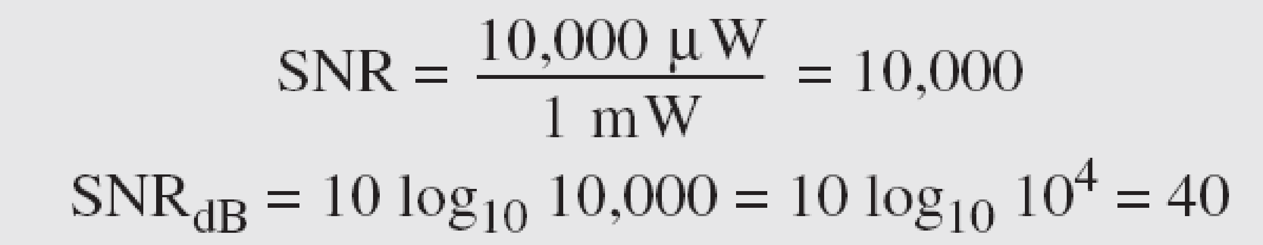
Example 3.31
The power of a signal is 10 mW and the power of the noise is 1 μW; what are the values of SNR and SNR_{dB} ?
Solution
The values of SNR and SNR_{dB} can be calculated as follows:

Slide 22
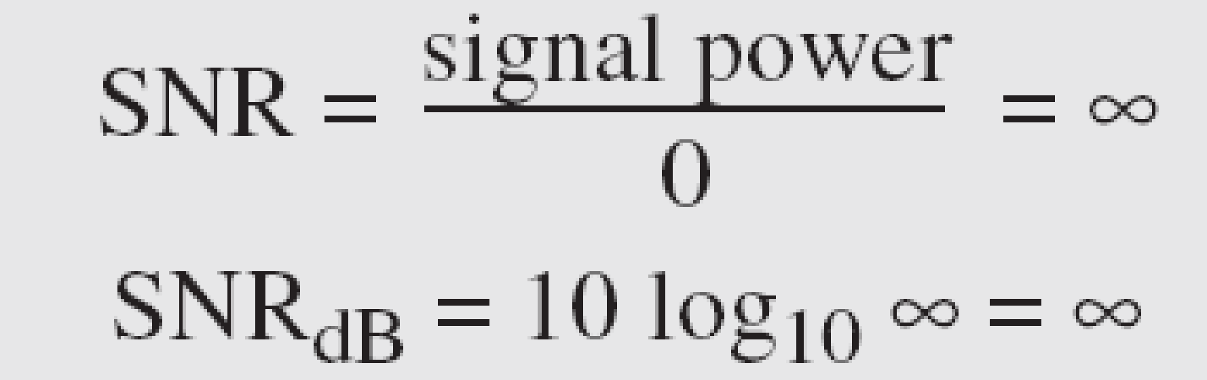
Example 3.32
The values of SNR and SNR_{dB} for a noiseless channel are
We can never achieve this ratio in real life; it is an ideal.

Slide 23
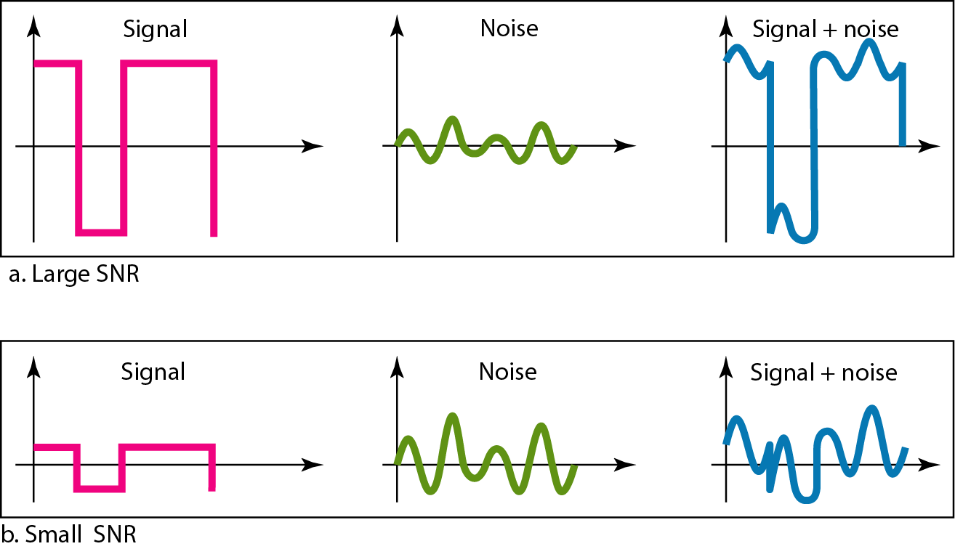
Figure 3.30 Two cases of SNR: a high SNR and a low SNR

